Slide 1
Dispelling the Curse of Dimensionality
Dependence Modelling with Vine Copulas
06 April, 2019
Ahmad Farhat

Slide 2
Copula is Latin for bond / unite.
Vine…
So… Am I at the correct address?
At a financial mathematics conference at AGH?
Or a botany conference, across the street at the Agriculture University?!

Slide 3
The Objective: Estimating High-Dimensional Distributions
Many applications in finance involve high-dimensional modelling. In risk management for instance:
Market Risk: risk measures (e.g. VaR) for large portfolios
Credit Risk: dependence strucutre of credit portfolios, joint probabilities of default
Liquidity Risk: comovements of bid-ask spreads for multiple underlyings
Portfolio Management: for ex. optimizing cVaR
Systemic Risk: interdependence among financial institutions (modelling for ex. using CDS)
Option Pricing: Options with multiple underlyings (e.g. basket options); hedging against a number of risks simultaneously
Notes:
2

Slide 4
The Curse: Dimensionality, No Separation of Concerns
Don’t need to go further than a few dimensions for the curse of dimensionality to kick in.
Typically no separation between modelling marginal distributions and modelling the joint dependence for multivariate distributions.
Most modeling aproaches are also inflexible in terms of allowing different dependence structures (linear, non-linear, time-varying, etc.) for different sub-components of a multivariate distribution.
“If you can't solve a problem, then there is an easier problem you can solve: find it.” ― George Polya – How to Solve It
Notes:
3

Slide 5
The Anti-dote: Taming Dimensionality with Vine Copulas
Break up the problem into smaller pieces that are tractable.
Copula-based approach:
Separation of the modelling of marginal distributions and the dependence structure of the full distribution.
Standard multivariate copulas become inflexible in high dimensions (rarely used for >10 dimensions).
Vine Copulas:
Using bivariate copulas as building blocks for high-dimensional distributions.
Dependence structure is determined by the bivariate copulas, and encoded in a nested set of trees.
Models could incorporate: time varying parameters, regime switching, non parametric models, etc.
Could be used even for dimensions >>100.
Vine Copulas allow for a very flexible and wide class of multivariate distributions!
Notes:
4

Slide 6
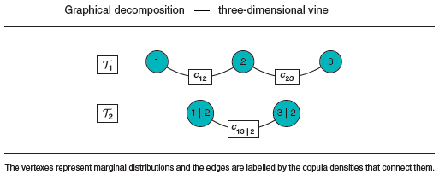
Sample Workflow
Estimate univariate marginals
Model selection and parameter estimation
Leading to estimation of the multivariate distribution
Run Monte Carlo simulations
1. Univariate marginal are estimated using parametric or non-parametric models of choice.
2. Model = structure (graphical model) + bivariate copula families
+ copula parameters
structure (graphical model)

Slide 7
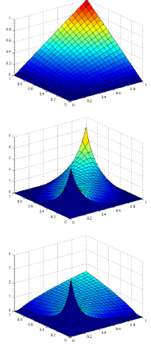
Sample Workflow
Bivariate copula families
Filling the edges, corresponding to (conditional) bivariate distributions, in the above structure
Estimate univariate marginals
Model selection and parameter estimation
Leading to estimation of the multivariate distribution
Run Monte Carlo simulations
Independence
Gaussian
Clayton
Typical families for financial applications:
Independence, Gaussian, Student t, Gumbel, Clayton, Frank

Slide 8
Sample Workflow
Estimate univariate marginals
Model selection and parameter estimation
Leading to estimation of the multivariate distribution
Run Monte Carlo simulations
3. After the estimation of the copula parameters, we arrive at the model.
For instance, the above structure determines the following decompositions:
$$Normal$$
ρ=0.6
$$Clayton$$
θ=2.5
$$Gumbel$$
θ=1.5

Slide 9
Sample Workflow
Estimate univariate marginals
Model selection and parameter estimation
Leading to estimation of the multivariate distribution
Run Monte Carlo simulations
In general, the distribution factorizes as:
Where “pairs” refers to (conditional) bivariate copulas.
There are two main modelling assumptions. Both are made in order for vine copula models to be tractable in practice.
Simplifying assumption: Bivariate conditional copula densities do not depend on the values of the variables on which they are conditioned.
Truncation: Each bivariate copula above a certain level in the tree structure is the independence copula. This assumption is checked to be typically suitable for financial applications, with truncation usually set at 2. With truncation, estimation should scale linearly in dimension.

Slide 10
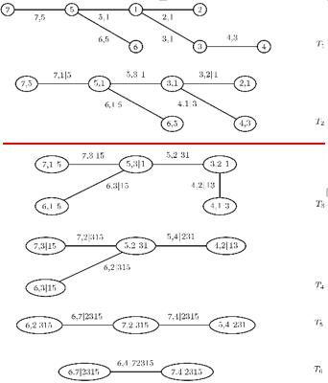
Sample Workflow
Estimate univariate marginals
Model selection and parameter estimation
Leading to estimation of the multivariate distribution
Run Monte Carlo simulations
Truncation:
Simplifying assumption:
does not depend on the value of x2

Slide 11
Sample Workflow
Estimate univariate marginals
Model selection and parameter estimation
Leading to estimation of the multivariate distribution
Run Monte Carlo simulations
Finally, the estimated multivariate distribution is used, typically in Monte Carlo simulations.
Monte Carlo paths are then used in various financial applications, for instance estimating risk measures (VaR, ES, etc.), basket option pricing, etc.

Slide 12
Typical Applications
Vine Copulas originated in early 2000s for applications in Extreme Value Theory, and in quantifiying risk for large complex systems involving uncertainty over hundreds of variables (European Union and US Nuclear Regulatory Commission studies for accidents at nuclear power plants).
Vine Copula models are being developed for financial risk management applications, with demonstrated recent interest from large financial institutions.
Vine Copulas are also used in a wide variety of applications involving complex systems (civil engineering, environmental science, etc.).
Vine Copulas allow in Machine Learning to avoid the typical computational cost for additional expressiveness / flexibility, through separating the univariate modelling from the dependence modelling.
Notes:
11

Slide 13
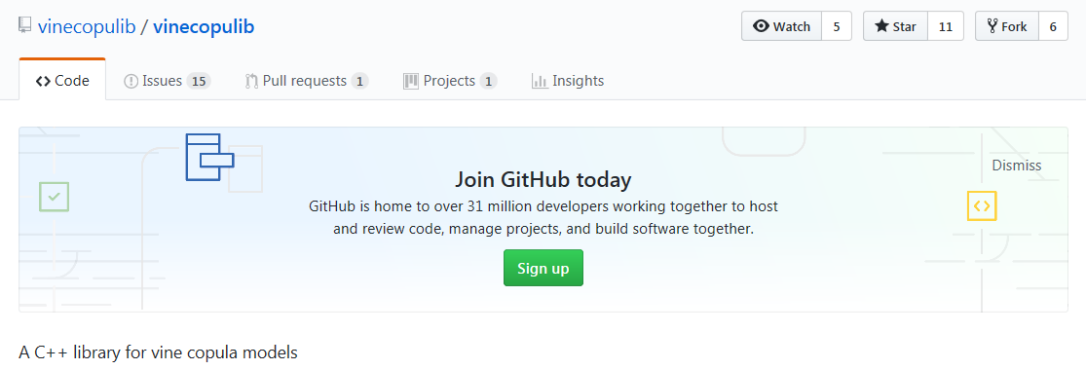
It works!
The method is especially well-suited for financial applications: promising literature on testing the modelling assumptions (simplifying assumption, truncation levels).
Allows on a typical PC to run analyzes for hundreds of dimensions (building a copula model for say ~50 dimensions on a personal laptop is a matter of minutes, not hours).
Tractable on scientific computing machines for dimensions in the hundreds.
Many software packages support the functionality, and are actively maintained: VineCopula (R), vinecopulib (C++ with Python and R wrappers), and other similar packages.
Notes:
12

Slide 14
But what about the risk?
The misfortune was the possibility to easily use (Gaussian) copulas, and to assume that they can definitively determine risk!
Since Vine Copulas offer a tempting way to avoid the computational price for additional flexibility, they must be treated with care. Even though preliminary tests for the modelling assumptions are promising, the bill for lunch always arrives, sooner or later!
Notes:
13

Slide 15
So what will a crisis associated with Vine Copulas be called?
The Grapes of Wrath?!
(Grona gniewu 2.0)
Sour Wine: The bottle that Killed Wall Street?

Slide 16
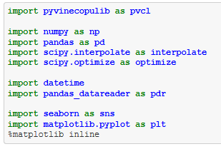
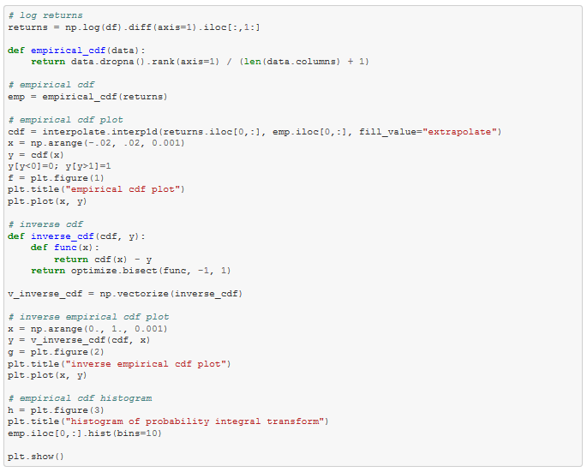
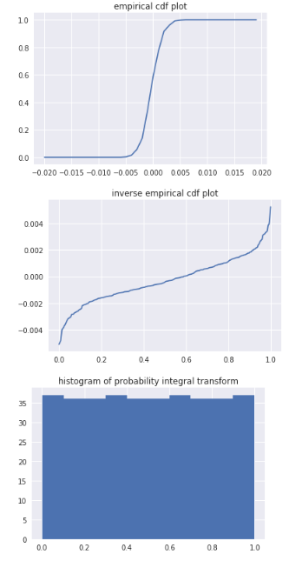
Sample Workflow in Python
Fitting and simulating from vine copulas
3. Fit the marginals
Download packages
2. Get the data
Notes:
15

Slide 17
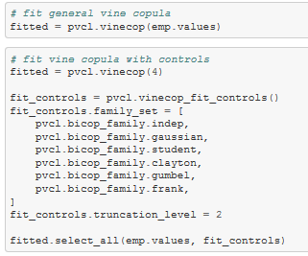
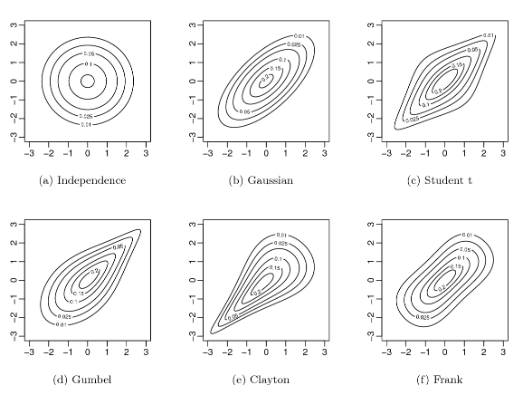
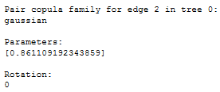
Sample Workflow in Python (cont.)
4. Fit a Vine Copula
4*. Commonly encountered in financial applications
4*. Access attributes
Notes:
16

Slide 18
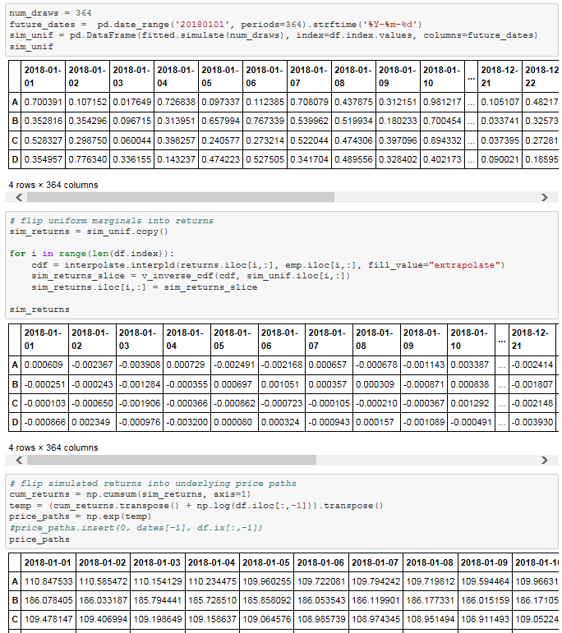
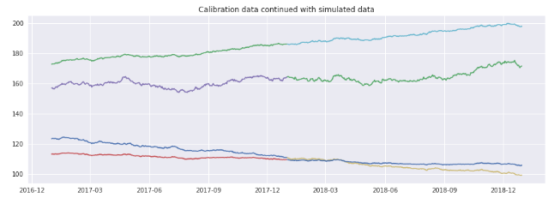
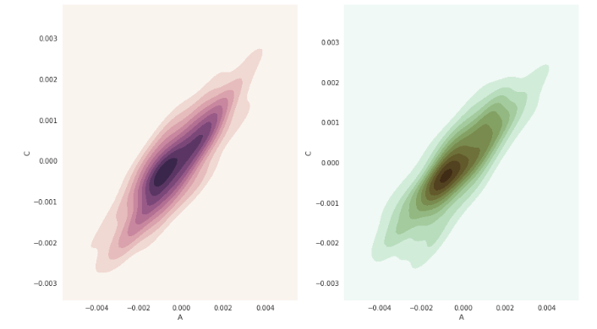
Sample Workflow in Python (cont.)
Step 5:
a. Simulate from the distribution
b. Flip uniform marginals into returns
c. Flip simulated returns into price paths
5. Simulate from the Vine Copula
6. Validation and testing
Notes:
17

Slide 19
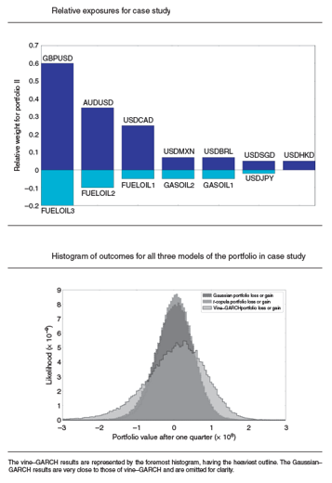
Financial Applications
Portfolio risk measures
Balance Sheet Management
Results from [5].
A portfolio consisting of exposures to several fuels and gas oils, as well as currencies.
The figures show the portfolio composition, the distribution of outcomes of different models, estimates of risk measures and comparison of backtesting results for the various models.
Monte Carlo simulations performed under the objective measure

Slide 20
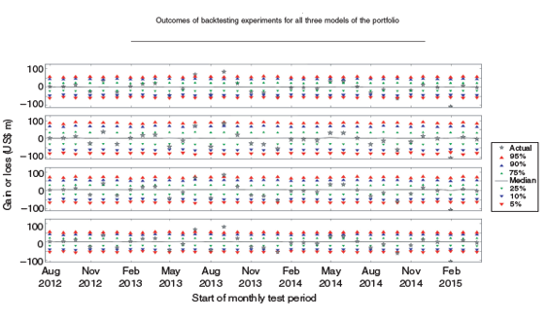
Financial Applications
Portfolio risk measures (contd.)

Slide 21
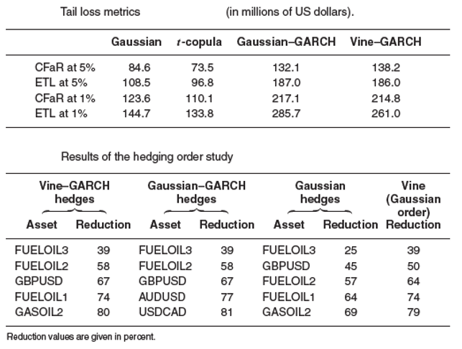
Financial Applications
Portfolio risk measures (contd.)

Slide 22
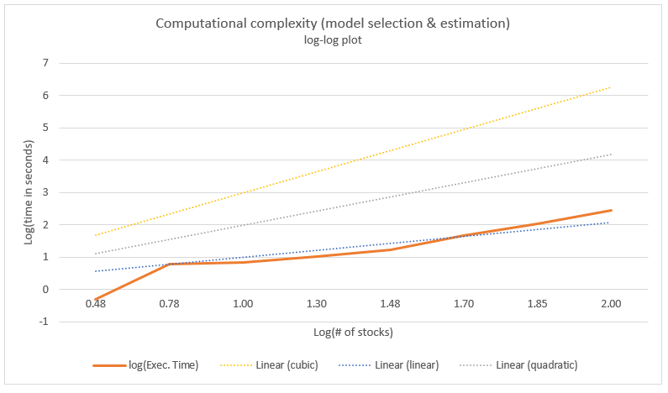
Financial Applications
Basket option pricing
Internship carried out at HSBC
Maciej Lewicki, AGH graduate
Valuing an option on a basket of 50 stocks
Data sourcing and preparation
Fitting marginal distributions, e.g. GARCH(1,1) models.
Pair-copula construction to fit the distribution of the underlying assets under the objective and risk-neutral measures.
Monte Carlo simulations for obtaining the price of options.
Figure on the right shows tests for the computational complexity, given we assume truncation.

Slide 23
Enjoy your vine!
References:
Kjersti Aas, “Pair-Copula Constructions for Financial Applications: A Review”, Econometrics 4 (43), 2016.
Claudia Czado, Carolre Bernard, “Multivariate option pricing using copulae”, Applied Stochastic Models in Business and Industry 29 (5), Jul. 2012.
Gal Elidan, Copulas and Machine Learning: http://pluto.huji.ac.il/~galelidan/Copulas%20and%20Machine%20Learning.pdf.
Harry Joe, Dependnece Modeling with Copulas, Monographs on Statistics and Applied probability 134, 2015.
Christopher Wells, Ahmad Farhat, Christopher Richardson, and Ryan Deering, “A Vine Copula–GARCH Approach to Corporate Exposure Management”, Journal of Risk 20 (2), 1–25, Dec. 2017.
Notes:
22

Slide 24
Disclaimer
This presentation has been prepared by HSBC Service Delivery (Polska) sp. z o.o. with a registered office located at Kapelanka 42A, 30-347 Krakow, Poland, registered in the District Court for Kraków-Śródmieście in Kraków, XI Commercial Division of the National Court Register, under the number KRS 0000310459, share capital (entirely paid) in the amount of 67 689 500,00 PLN, NIP 525-242-91-07, hereinafter referred to as “HSBC”.
HSBC has based this document on information obtained from sources it believes to be reliable but which has not been independently verified. While this information has been prepared in good faith, no representation or warranty, express or implied, is or will be made and no responsibility or liability is or will be accepted by the HSBC, or by any of their respective officers, employees or agents in relation to the accuracy or completeness of the Documents or any other written or oral information made available to any interested party or its advisers and any such liability is expressly disclaimed. Any charts and graphs included are from publicly available sources or proprietary data. No liability is accepted whatsoever for any direct, indirect or consequential loss arising from the use of this document. HSBC is under no obligation to keep current the information in this document. You are solely responsible for making your own independent appraisal of and investigations into the data, products, financial instruments and transactions referred to in this document and you should not rely on any information in this document as constituting investment advice. Neither HSBC nor any of its affiliates are responsible for providing you with legal, tax or other specialist advice and you should make your own arrangements in respect of this accordingly. The issuance of and details contained in this document, which is not for public circulation, does not constitute an offer or solicitation for, or advice that you should enter into, the purchase or sale of any security, commodity or other financial instrument or master agreement, or any other contract, agreement or structure whatsoever. This document is intended to be distributed in its entirety. Reproduction of this document, in whole or in part, or disclosure of any of its contents, without prior consent of HSBC or any associate, is prohibited.
Notes:
23

